Slide 1



PLAGIARISM
DETECTOR
Ishaa (L004), Arpita (L005)

Slide 2
TABLE OF CONTENTS
01
02
03
04
05
06
PROBLEM STATEMENT
DATA STRUCTURES
ALGORITHMS
CODE SNIPPETS
OUTPUT
FUTURE SCOPE

Slide 3
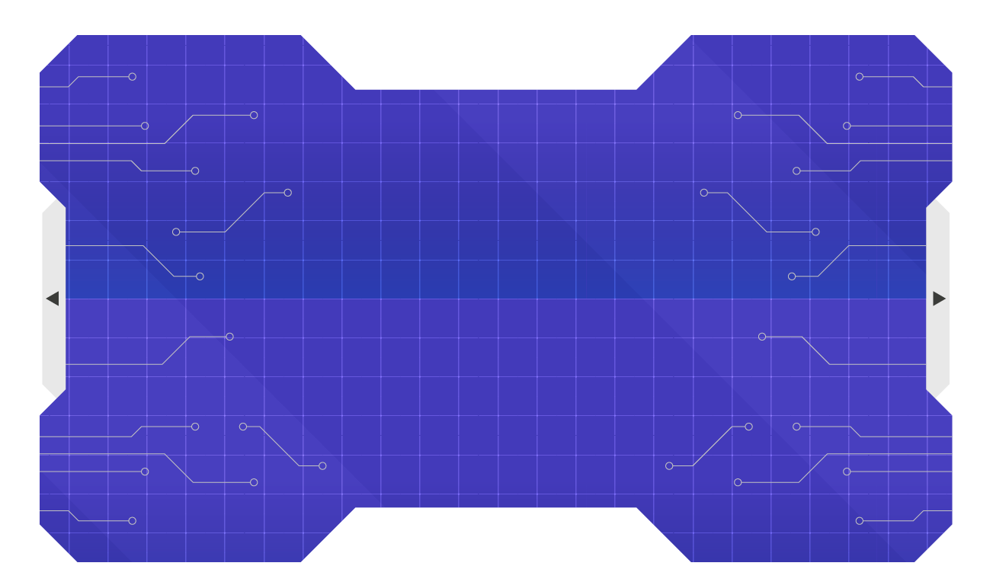
01
PROBLEM STATEMENT

Slide 4

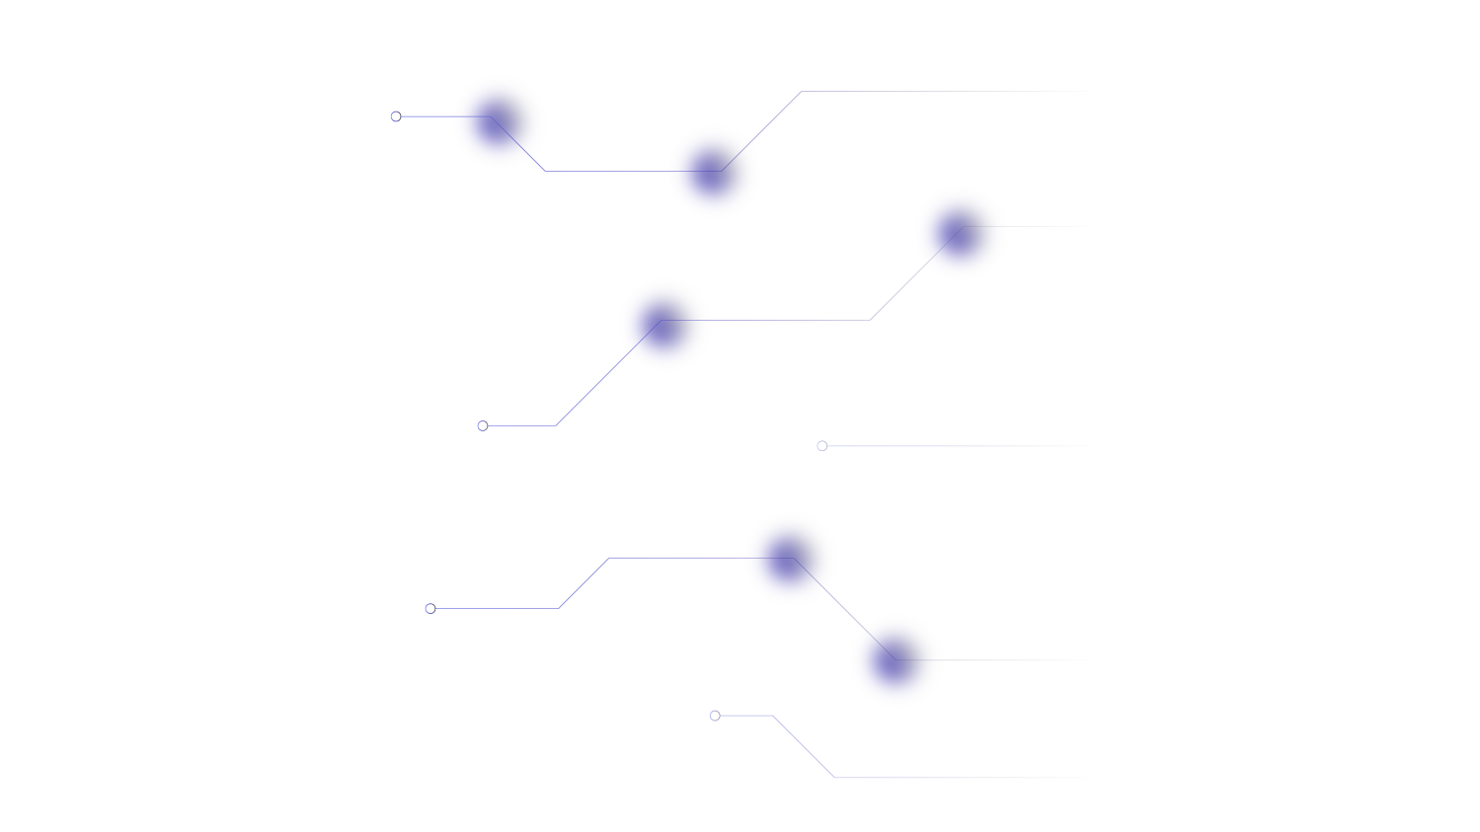
PROBLEM STATEMENT
•With the rise of digital content, detecting plagiarism has become a major challenge in both academic and professional domains. Traditional methods often miss paraphrasing, word rearrangements, and synonym usage.
•Our goal is to develop a C++-based plagiarism detection system that uses LCS, N-Grams, and synonym analysis to identify similar content—even when rephrased—with high accuracy. After calculating the plagiarism percentage, the system highlights matched phrases and provides intelligent synonym suggestions to help users rephrase their content and reduce similarity, promoting original writing.

Slide 5
HOW IT WORKS
Uses LCS to detect exact matching word sequences.​
N-Grams (configurable size) capture phrase-level similarities.​
Word frequency overlap reveals suspicious repeated content.​
Synonym dictionary offers suggestions for rewriting plagiarized content.​
Handles case-insensitive comparison and punctuation cleaning.

Slide 6
02
DATA STRUCTURES

Slide 7
DATA STRUCTURES
vector<string>: Token storage, LCS, N-Grams, synonym lists.​
string: Handles text input, tokens, and phrases.​
unordered_set<string>: Fast n-gram lookup and duplication check.​
unordered_map<string, vector<string>>: Synonym dictionary.​
unordered_map<string, int>: Frequency counter for words.​
unordered_map<string, string>: Maintains original casing of repeated words.​
pair<string, int>: Frequency sorting with associated words.

Slide 8
03
ALGORITHMS

Slide 9
ALGORITHMS USED
N-GRAMS +
MERGESORT
LCS(DP)
Matches exact sequences.
GREEDY SYNONYMS SUGGESTION
Detects and sorts matching phrases.
Recommends alternative phrases based on frequency.

Slide 10
System Flow
1. Read base document (Dataset.txt)​
2. Accept user input (user_dataset.txt)​
3. Tokenize both documents into words​
4. Run LCS and N-Gram comparisons​
5. Load synonyms from dictionary from synonymsMap​
6. Match and display plagiarized phrases​
7. Suggest alternate words or phrases from synonyms_data.txt

Slide 11
KEY FUNCTIONAL BLOCKS
tokenize(): Separates words for processing.​
longestCommonSubsequence(): Finds similar sequences.​
getNGrams(): Creates sliding window phrases.​
mergeSort(): Sorts frequent n-grams or matches.​
matchedNGrams(): Identifies overlapping phrases.​
loadSynonyms(): Loads word-alternatives.​
suggestWordsToChange(): Offers replacement suggestions.

Slide 12
04
CODE SNIPPET

Slide 13
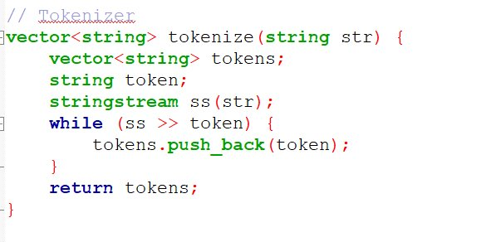
Function: tokenize()

Slide 14
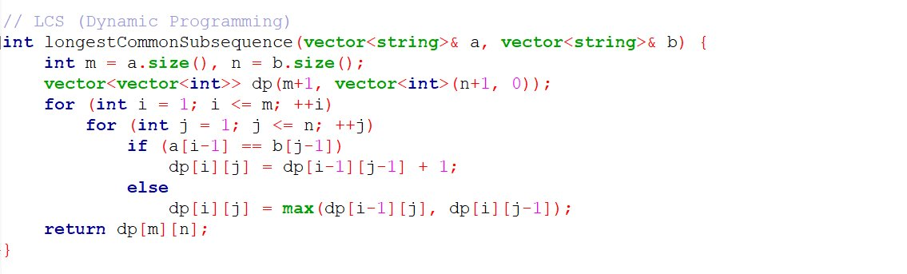
Function: longestCommonSubsequence()

Slide 15
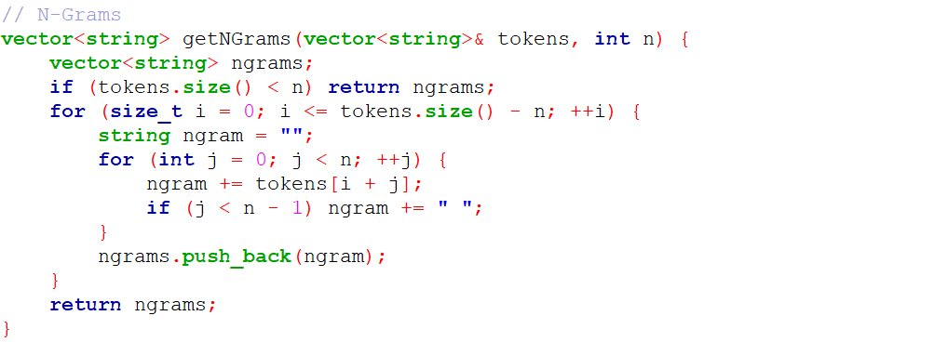
Function: getNGrams()

Slide 16
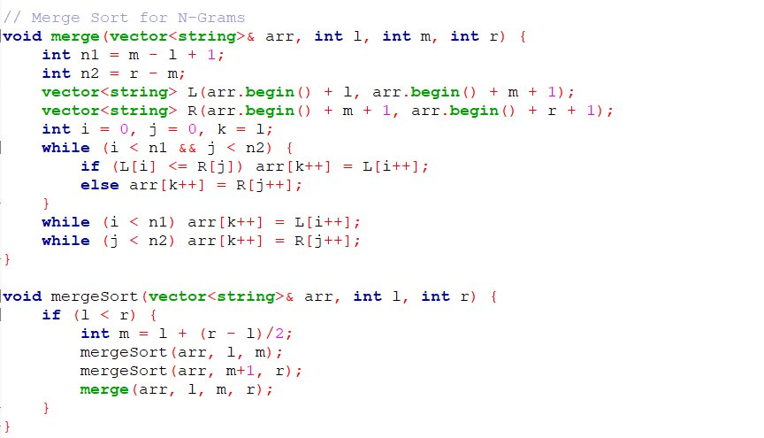
Function: mergeSort()

Slide 17
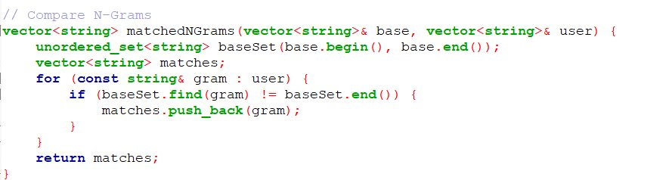
Function: matchedNGrams()

Slide 18
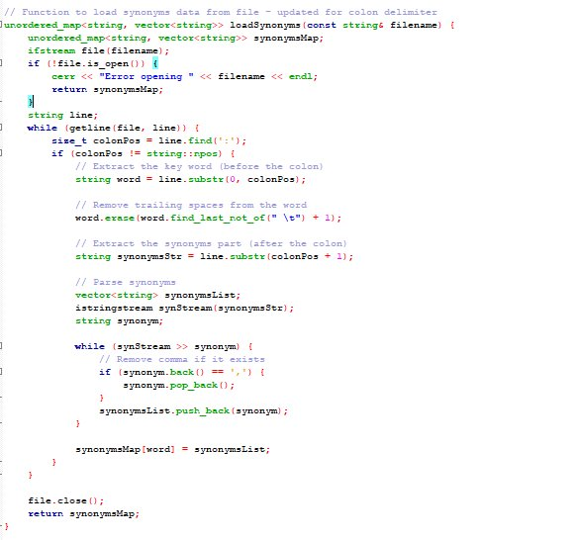
Function: loadSynonyms()​

Slide 19
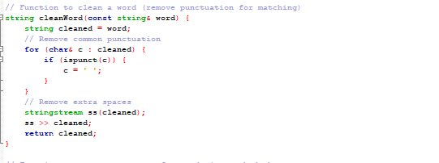
Function: cleanword()​

Slide 20
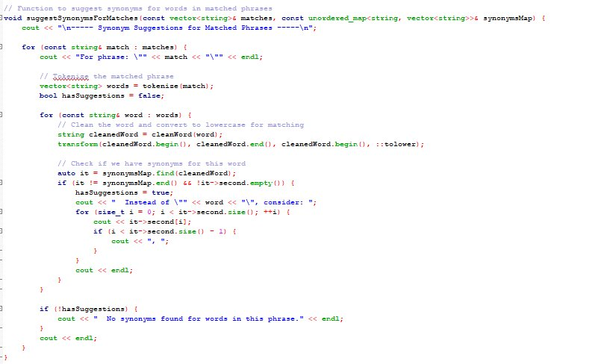
Function: suggestSynonymsForMatches()​

Slide 21
05
OUTPUT

Slide 22
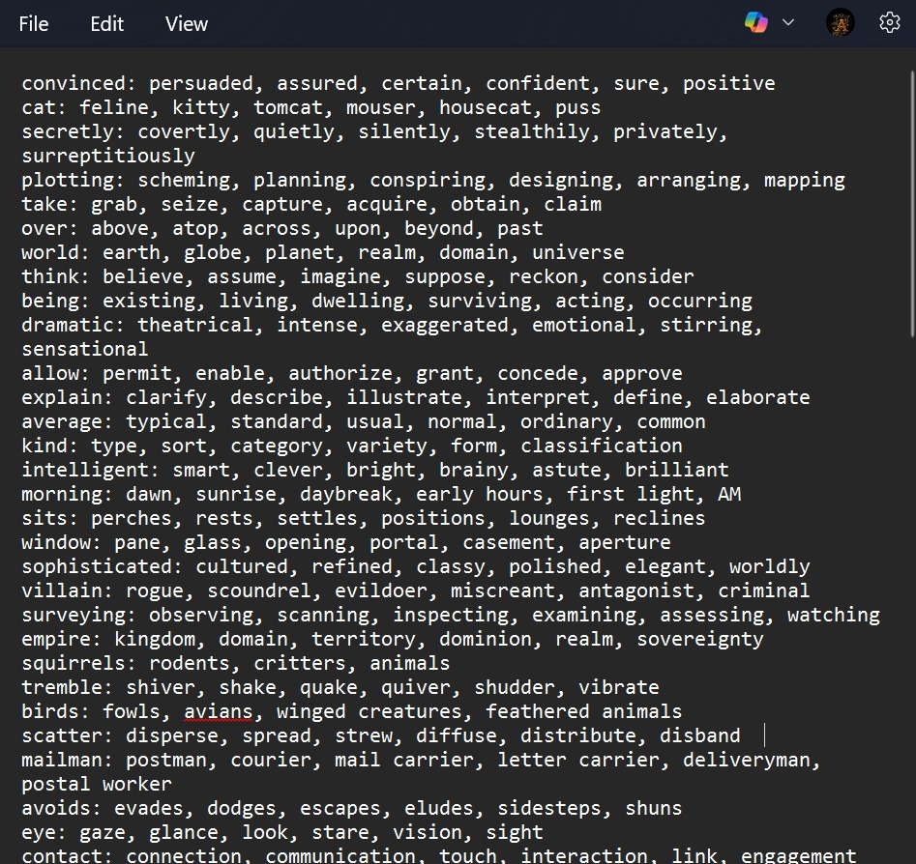
DATASET FOR STORING SYNONYMS

Slide 23
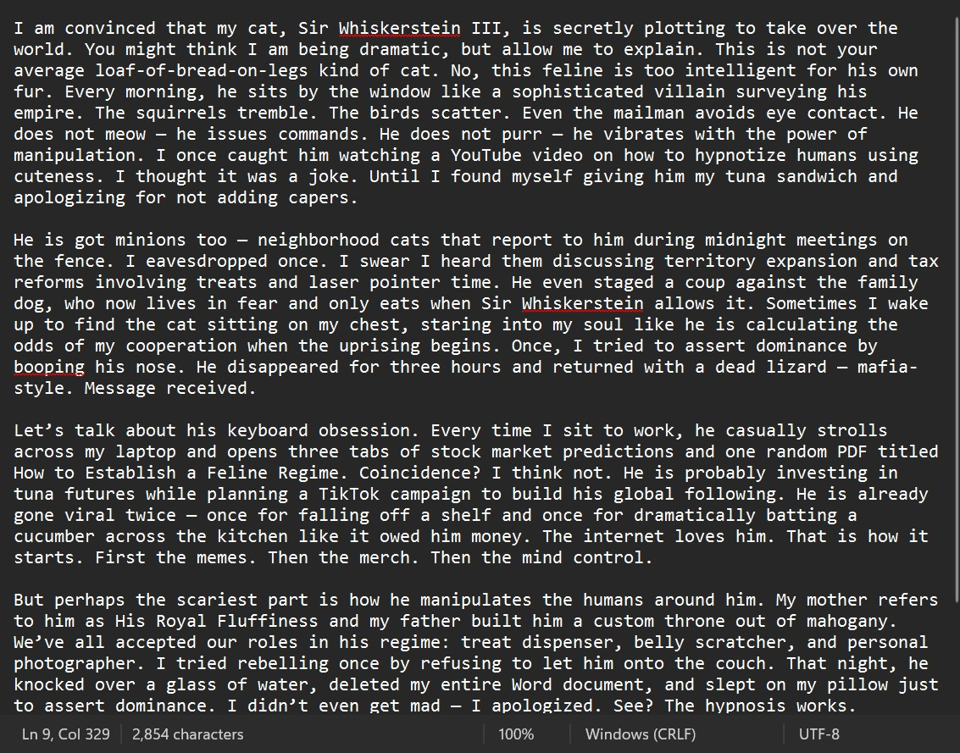
DATASET
FOR STORING ORIGINAL TEXT

Slide 24
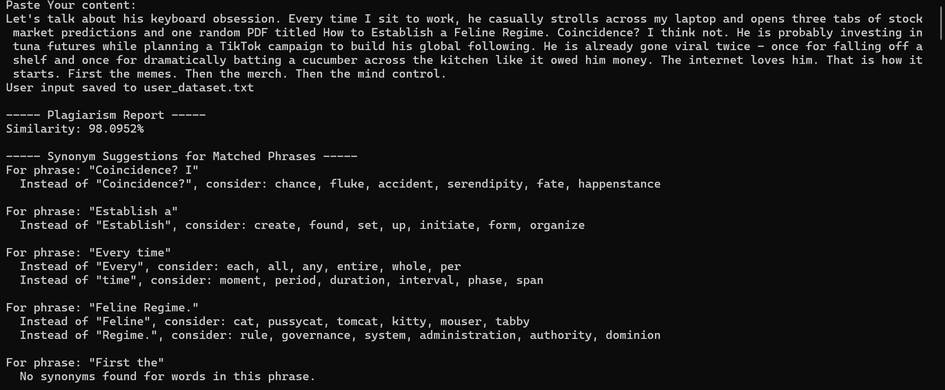
OUTPUT

Slide 25
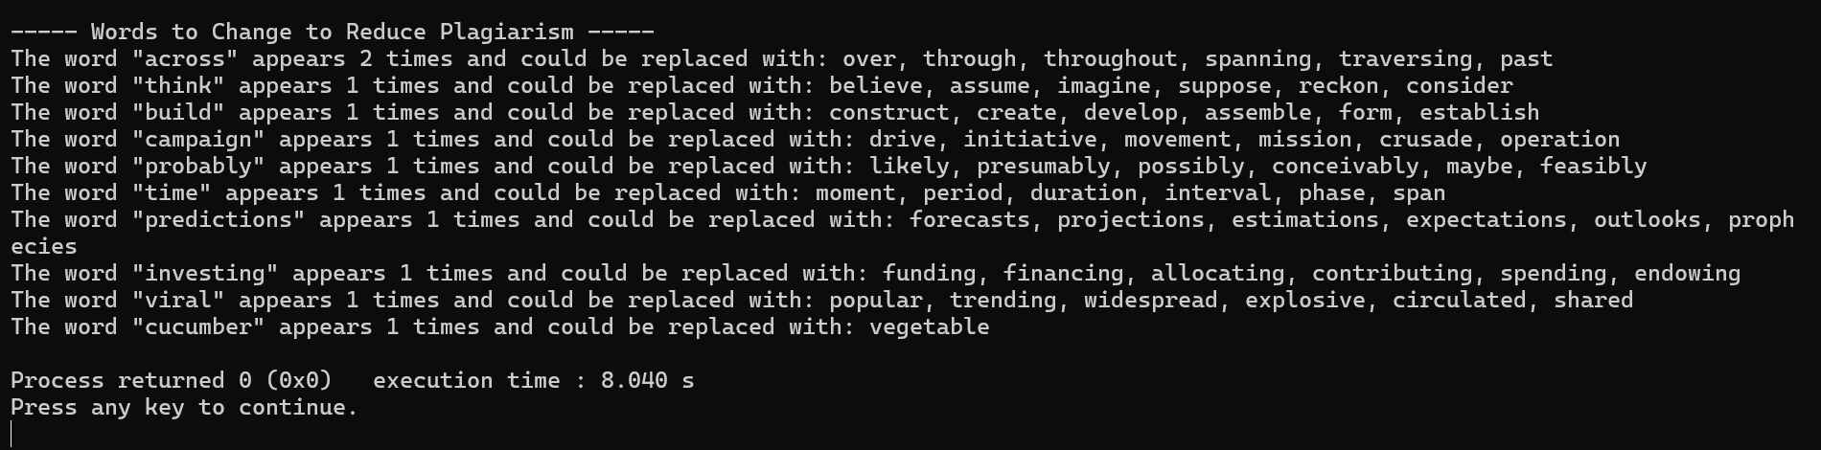
OUTPUT

Slide 26
TIME COMPLEXITY
O(B + U) // Tokenization
+ O(B * U) // LCS
+ O(B + U) // N-Grams
+ O(B log B + U log U) // Merge Sort
+ O(B + U) // Matching
+ O(S) // Load Synonyms
+ O(M) // Synonym Suggestions
+ O(U) // Word Suggestion
B = number of words in base text
U = number of words in user input
S = number of synonym entries
M = matched phrases
Dominant Terms:
O(B * U) from LCS (quadratic)
O(B log B + U log U) from Merge Sort
Final Time Complexity: O(B * U + B log B + U log U + S + M)

Slide 27
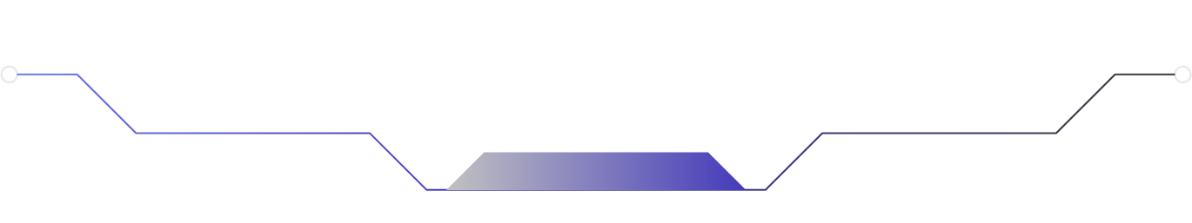

Scope of Improvement
Add NLP-based semantic similarity (e.g., spaCy, BERT).​
GUI-based interface for non-technical users.​
Export detailed plagiarism reports (PDF, DOCX).​
Integrate with real-time file uploads and plagiarism history.

Slide 28
THANK YOU

